Slide 1
Cochlear Implant and Intelligibility Predictors
Enoch Hsin-Ho Huang 黃心和
Research Center for IT Innovation, Academia Sinica
2020/7/8
Notes:
1

Slide 2
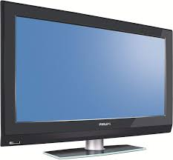

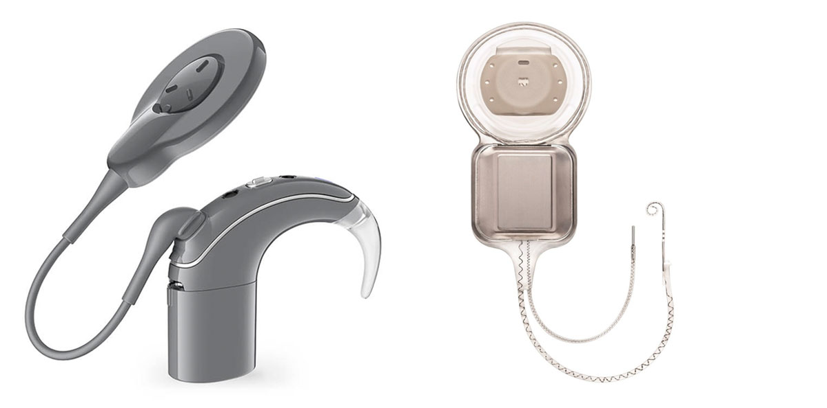




About Me

Slide 3
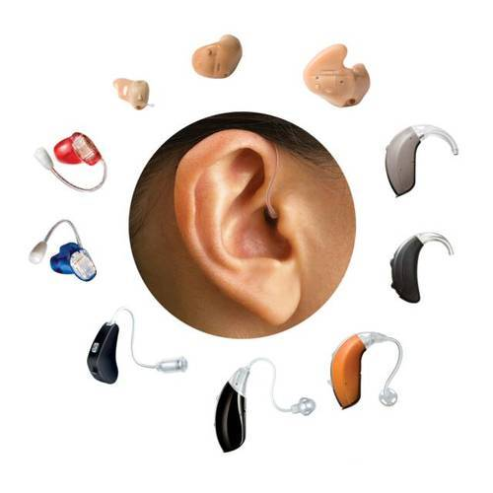
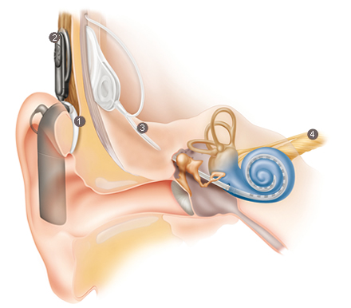
Hearing Aid (HA) & Cochlear Implant (CI)
https://www.indiamart.com/proddetail/gn-resound-digital-hearing-aids-2847120891.html
https://www.cochlear.com/au/home/understand/hearing-and-hl/hl-treatments/cochlear-implant

Slide 4

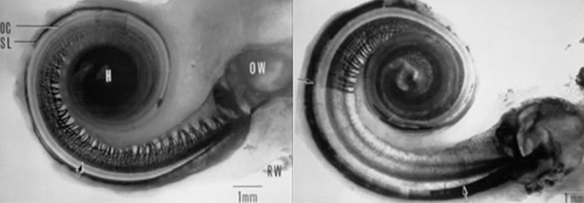
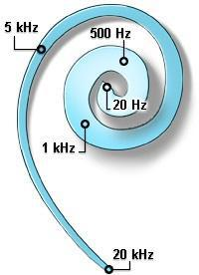
If hair cells in the cochlear are damaged, the auditory neurons cannot be excited ➔ hearing loss
https://www.newsoundhearing.com/blog/sensorineural-hearing-loss/
Image:
mjc.edu
hair cell
https://www.cochlear.com/au/home/understand/hearing-and-hl/hl-treatments/cochlear-implant
Apex
https://www.faa.gov/about/initiatives/maintenance_hf/fatigue/publications/media/Aviation-MX-Human-Factors-Newsletter-Vol1-Issue3.pdf
Base
Image:
cochlea.eu
Notes:
FFT, Frequency Analyzer

Slide 5
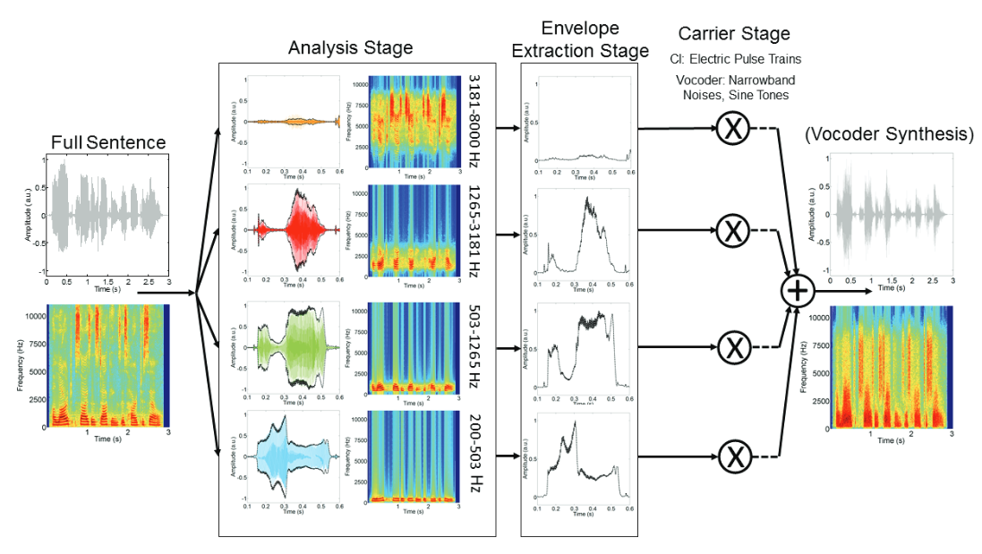
CI Strategy, Stimulation & Simulation
Processing Strategy Coding Strategy
Goupell, M. J. (2015). Pushing the envelope of auditory research with cochlear implants. Acoustics Today, 11, 26-33.

Slide 6
CI Strategy, Stimulation & Simulation
Stimulation
https://www.cochlear.com/au/home/understand/hearing-and-hl/hl-treatments/cochlear-implant
Goupell, M. J. (2015). Pushing the envelope of auditory research with cochlear implants. Acoustics Today, 11, 26-33.

Slide 7

CI Strategy, Stimulation & Simulation
Vocoder
Simulation
White Noise / Pure Tone as Carriers
Goupell, M. J. (2015). Pushing the envelope of auditory research with cochlear implants. Acoustics Today, 11, 26-33.

Slide 8
CI Limitations
Hearing in noisy environment
Tonal Languages (Mandarin, Cantonese, etc.)
Music Performance
Possible solutions
Hair cell regeneration
Replace electric stimulation (electrode interface) by
Ions (artificial synapse)
Light/LED (optogenetics)
CI signal processing algorithms - Beamforming, NR, Coding Strategy

Slide 9
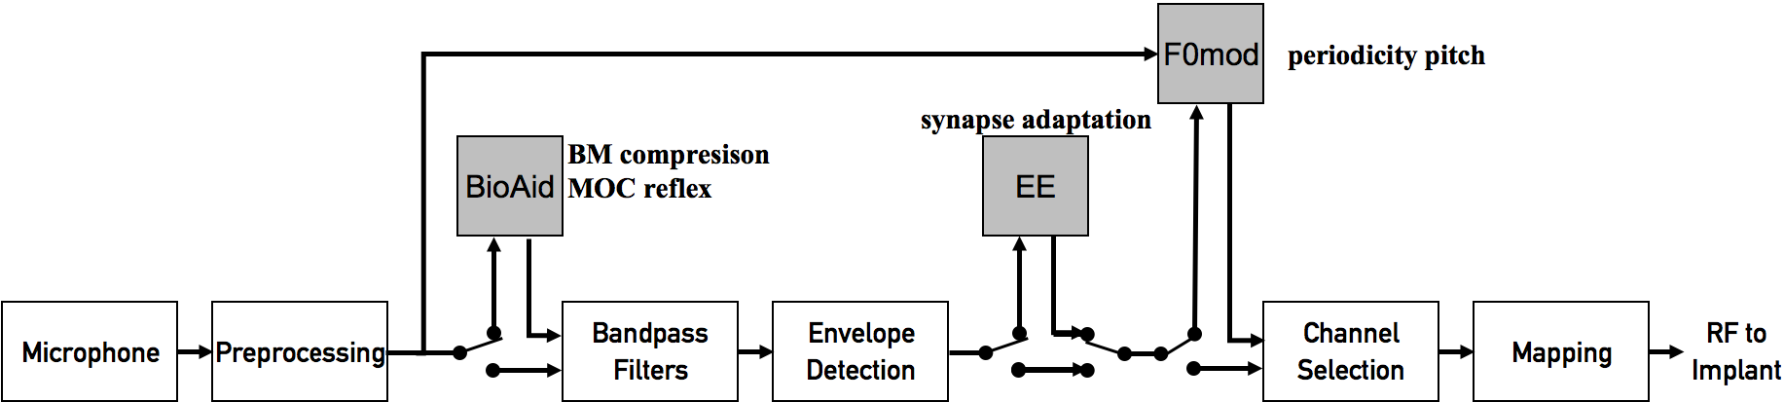
Combination of Coding Strategies

Slide 10
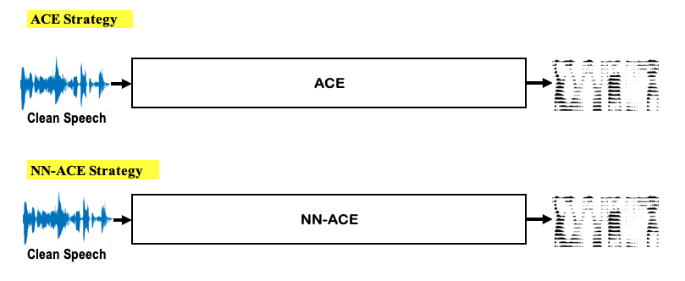
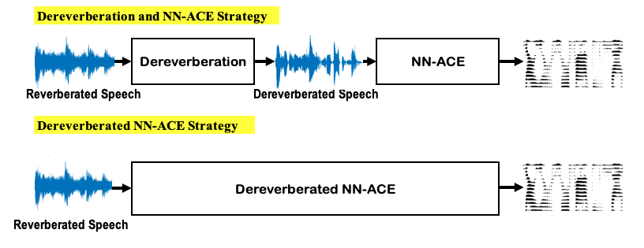
ElectrodeNet – Deep Learning Based Strategy
ACE
ElectrodeNet
Dereverberated/SE ElectrodeNet

Slide 11
Evaluation of CI Sound Processing
CI Subjects
Normal-Hearing Simulation
https://www.cochlear.com/au/home/understand/hearing-and-hl/hl-treatments/cochlear-implant

Slide 12
Evaluation of CI Sound Processing
CI Subject Hearing Test ➔ Time-consuming ➔ Variability among CI users ➔ Special sound processing equipment
Normal-Hearing Subject Hearing Test ➔Similar limitations as CI subjects ➔Simulated CI sound with vocoder
Objective Prediction Measures ➔ STOI, PESQ, etc.
IRB Procedure for human experiments

Slide 13
Audibility
Intelligibility
Quality
Assumptions for Prediction:
Bands with positive SNR contribute to intelligibility.
Prediction based on linearly weighted band SNRs.
Band Importance Function (BIF)

Slide 14
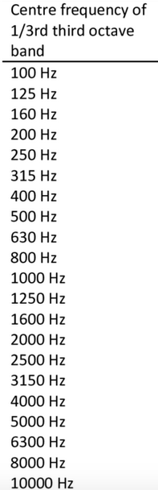
Piercy, J. J. B. (2015). The Relevance of Coral Reed Soundscapes to Larval Fish Responses (Doctoral dissertation, University of Essex).
Band Interval:
AI – non-octave bands
SII, STOI – 1/3-octave bands
STI, NCM – Octave-wide bands
Number of Bands:
AI – 20 bands. Several versions
SII – 18 bands (160, 200, 250, … 8000 Hz)
STI – 7 bands (250, 500, 1000, …, 8000Hz)
NCM – 20 bands (335, 410, 496, …, 6908Hz)
STOI – 15 bands (150, 189, 238, 200,…, 3810Hz)
Octave Bands
STI
SII
Notes:
AI – See Matlab code https://www.mathworks.com/matlabcentral/fileexchange/21474-articulation-index SII – See Matlab code http://sii.to/programs.html http://sii.to/siito/assets/siimatlab.zip

Slide 15
Conclusion
STOI is not good enough for CI vocoded speech.
No objective predictor is perfect.
Sound processing algorithms for CIs and objective predictors are required to be improved.
Non-intrusive measures for CI??

Slide 16
Thank you

